Slide 1
DSCI-6003 – MACHINE LEARNING
SMART TRAFFIC VOLUME PREDICTION USING MACHINE LEARNING
Team Members
Shruthi Darwaja
Dharmika Gali
Bharadwaj Gottimukkula
Dinesh Reddy Kunduru

Slide 2
Project OBJECTIVE
Analyze traffic patterns across different cities and regions
Understand hourly and daily variations in traffic flow
Develop machine learning models to predict vehicle volume
Identify peak and off-peak traffic conditions
Visualize traffic insights using an interactive dashboard
Enable data-driven and proactive traffic management
Build a scalable system suitable for smart-city integration

Slide 3
Dataset & Data Description
Simulated but realistic urban traffic dataset
Hourly traffic records across multiple cities and states
Combines spatial and temporal features
Designed to model real-world traffic behavior
Target variable represents traffic intensity

Slide 4
Data Preprocessing & Feature Engineering
Imported traffic dataset and validated data integrity
Checked and handled missing or inconsistent values
Converted timestamp column into datetime format
Extracted temporal features from timestamp
Created Day Of Week feature to capture weekly patterns
Created Hour Of Day feature to capture daily traffic cycles
Encoded categorical day values into numerical representation
Verified realistic traffic distribution after preprocessing
Selected relevant features for model input
Defined Vehicle Count as the prediction target
Structured dataset for machine learning models
Ensured consistency between ML pipeline and dashboard data

Slide 5
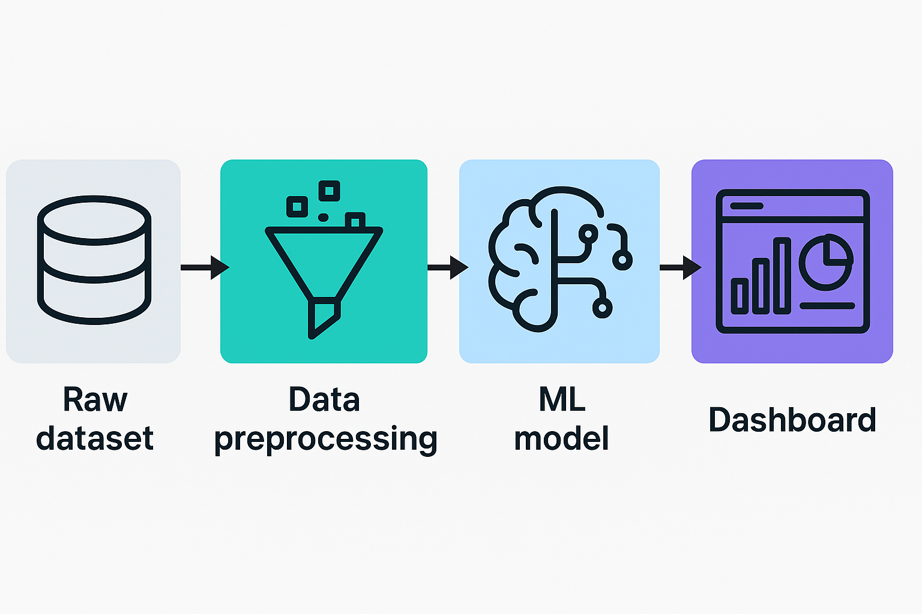
System Architecture

Slide 6
Workflow
Data Collection:
Traffic data is collected from the dataset containing city, state, timestamp, day of week, hour of day, and vehicle count.
Raw Dataset Storage:
The collected traffic data is stored in its original form without any modification to preserve data integrity.
Data Preprocessing:
The raw data is cleaned, formatted, and transformed.
Timestamps are parsed to extract meaningful time-based features such as Day Of Week and Hour Of Day.
Feature Engineering:
Relevant features are selected, and categorical variables are encoded.
The target variable, Vehicle Count, is prepared for prediction.
Visualization & Dashboard:
Predicted and historical traffic results are displayed through an interactive dashboard, enabling easy analysis and decision-making.

Slide 7
Machine Learning Models
Random Forest Regressor
Supervised machine learning regression model
Trained using historical traffic data
Uses time-based features such as Hour Of Day and Day Of Week
Learns relationships between time and vehicle count
Generates predicted traffic volume values
LSTM Neural Network
Deep learning model designed for time-series data
Processes sequential traffic information
Uses past traffic values to predict future traffic volume
Learns temporal traffic patterns automatically
Outputs predicted traffic volume over time

Slide 8
PROBLEM
Rapid urbanization has increased traffic volume significantly
Traffic congestion leads to delays, fuel wastage, and economic loss
Air pollution increases due to prolonged vehicle idling
Emergency services are delayed due to unpredictable traffic
Existing traffic systems are mostly reactive
Lack of accurate traffic prediction limits proactive planning
Manual or rule-based systems cannot adapt to dynamic traffic patterns
Absence of data-driven decision-making tools

Slide 9
Use-cases & Practical Applications
Real-time traffic congestion monitoring and prediction
Adaptive traffic signal control at intersections
Smart route planning and congestion avoidance
Emergency vehicle traffic management
Urban transportation and infrastructure planning
Peak-hour and special event traffic management
Environmental impact and emission reduction analysis
Support for smart city and intelligent transport systems

Slide 10
Advantages of the System
Enables predictive rather than reactive traffic management
Improves traffic flow efficiency and congestion contro
Supports data-driven decision making for authorities
Provides real-time and interactive traffic insights
Enhances urban mobility and commuter experience
Scalable architecture suitable for smart city deployments
Reduces fuel consumption and environmental impact
User-friendly dashboard requiring minimal technical knowledge
Flexible framework that can integrate real-time data sources

Slide 11
Future Work & Enhancements
Integrate real-time traffic data from sensors and APIs
Incorporate GPS and IoT-based traffic information
Extend model training using larger, real-world datasets
Apply advanced deep learning models for higher accuracy
Implement real-time traffic congestion alerts
Enable dynamic traffic signal optimization
Improve dashboard with live updates and forecasting
Expand system to additional cities and regions
Add anomaly detection for accidents and special events
Enhance system scalability and performance

Slide 12
Conclusion
Designed and implemented an end-to-end Smart Traffic Management System
Collected, processed, and analyzed time-based traffic datasets
Applied machine learning models to predict vehicle traffic volume
Compared traditional ML and deep learning approaches
Built an interactive and user-friendly traffic dashboard
Enabled data-driven and proactive traffic decision-making
Demonstrated realistic traffic patterns and congestion behavior
Scalable architecture suitable for smart city implementation
Strong foundation for real-time intelligent transportation systems

Slide 13
THANK YOU

